Slide 1
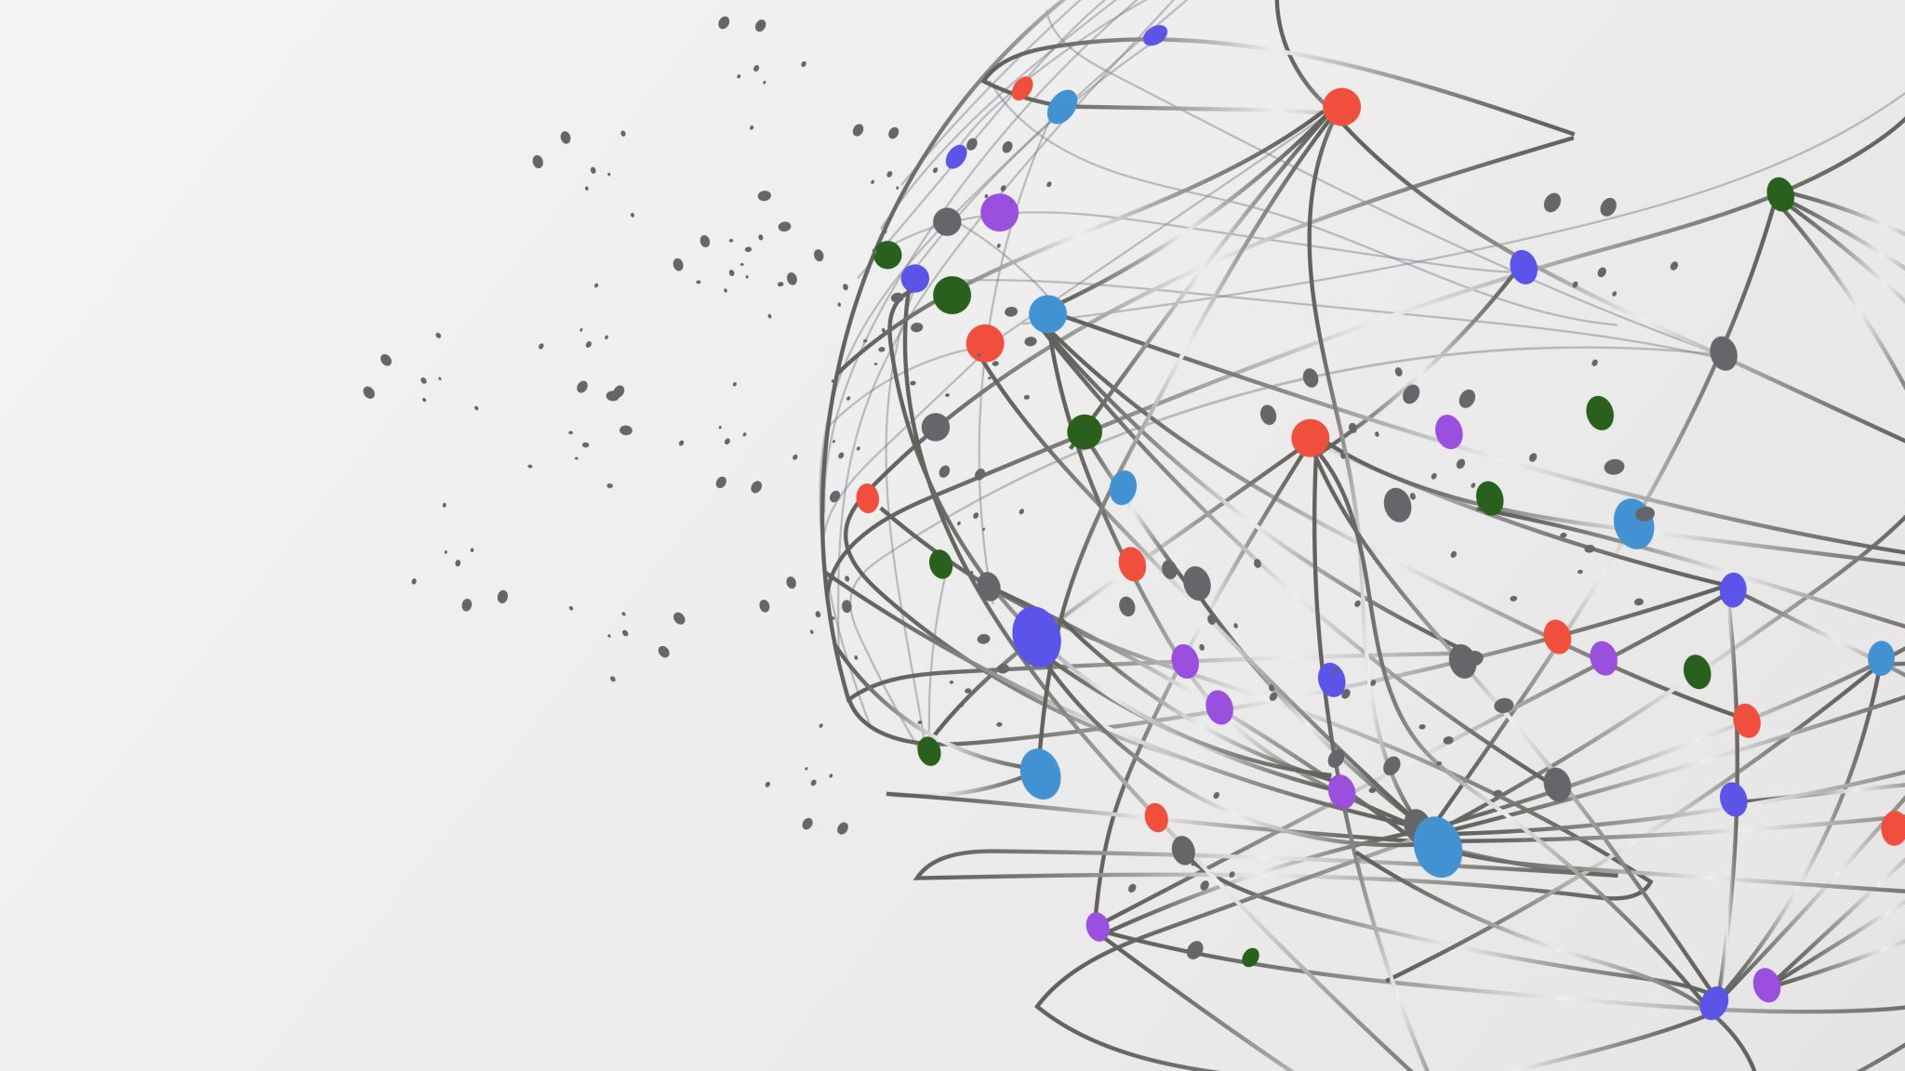
ASCII ART
Kane, Cory, Trent, Trevor, Kyle

Slide 2
Advancements
Image Conversion Algorithm
Progress on GUI and file selection

Slide 3
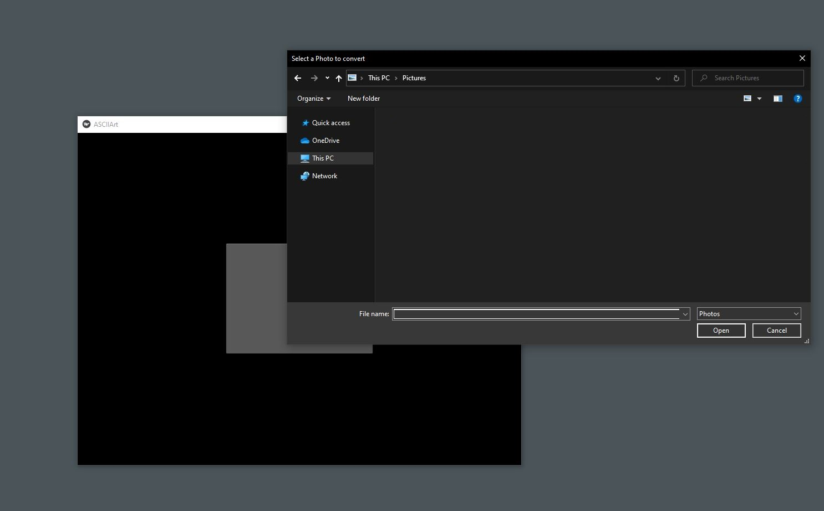

Slide 4
Current Roadblocks
Image generation from conversion
Image scaling post-conversion

Slide 5
Upcoming developments and goals
Connecting our image conversion algorithm with our GUI
Refinement of the conversion algorithm

